Slide 1
Veterans, Traumatic Brain Injury, and Suicide Lisa A. Brenner, Ph.D.
Rocky Mountain Mental Illness, Research, Education and Clinical Center (MIRECC)
University of Colorado, Anschutz Medical Campus

Slide 2
“I think it took awhile before I realized and then when I started thinking about things and realizing that I was going to be like this for the rest of my life, it gives me a really down feeling and it makes me think like—why should I be around like this for the rest of my life?” - VA Patient/TBI Survivor

Slide 3
Rocky Mountain MIRECC Mission
The mission of the Rocky Mountain MIRECC is to study suicide with the goal of reducing suicidal ideation and behaviors in the Veteran population.
The work of the Rocky Mountain MIRECC is focused on promising clinical interventions, as well as the cognitive and neurobiological underpinnings of suicidal thoughts and behaviors that may lead to innovative prevention strategies.
Please visit us on our website:
www.mirecc.va.gov/visn19/
Notes:
The vision of the Rocky Mountain MIRECC is: Veterans, their families, and the VHA will have increased information and options to make health decisions aimed at decreasing suicide risk.

Slide 4
TBI and Suicide - Articles in Medline (1985 to 2014)

Slide 5
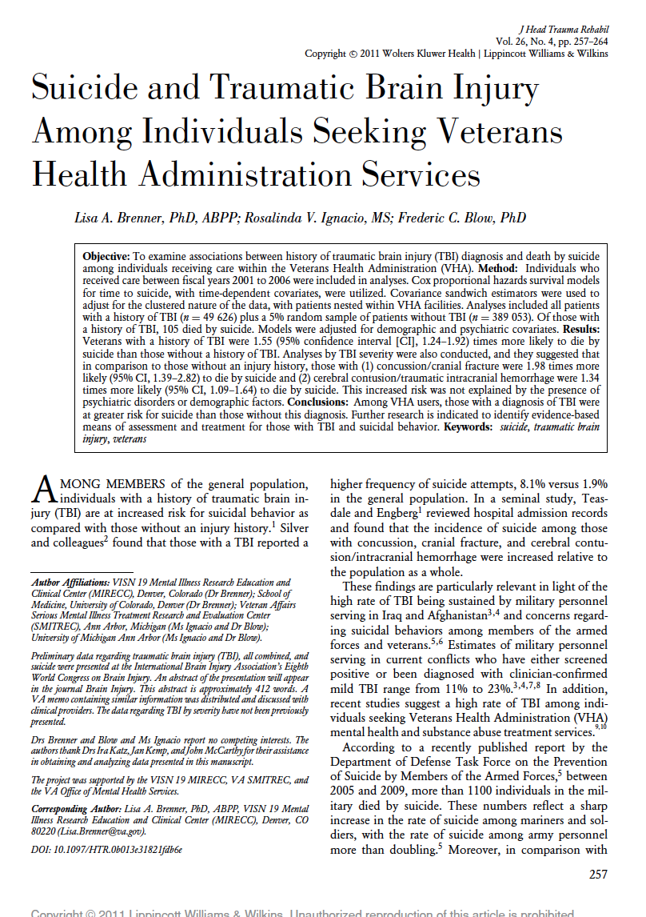
Suicide and TBI in Veterans
Individuals who received care between FY 01 and 06
Analyses included all patients
with a history of TBI (n = 49, 626) plus a 5% random sample of patients without TBI (n = 389,053)
Suicide - National Death Index (NDI) compiles death record data for all US residents from state vital statistics offices
TBI diagnoses of interest were similar to those used by Teasdale and Engberg
Challenges associated with this type of research and need for collaboration (~8 million records reviewed)

Slide 6
Suicide and TBI in Veterans
ICD-9 codes:
1) concussion (850), cranial fracture—fracture
of vault of skull (800), fracture of base of skull (801), and other and unqualified skull fractures (803)
(2) cerebral laceration and contusion (851); subarachnoid,
subdural, and extradural hemorrhage after injury (852); other and unspecified intracranial hemorrhage after injury (853); and intracranial injury of other and unspecified
nature (854).
Cox proportional hazards survival models for time to suicide, with time-dependent covariates, were utilized.
Covariance sandwich estimators were used to
adjust for the clustered nature of the data, with patients nested within VHA facilities.

Slide 7
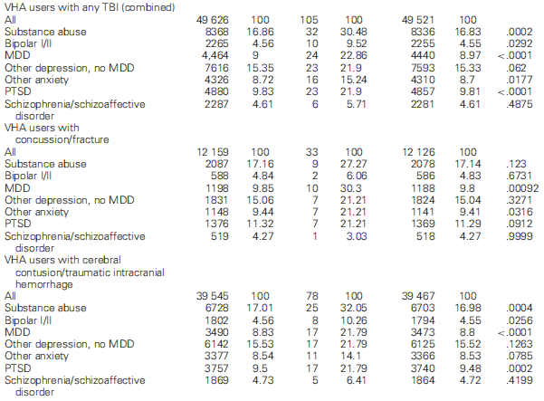

Slide 8
Hopelessness - strong risk factor for suicide among non-brain injured cohorts with greater predictive power than depression
35% of those with TBI endorsed moderate to severe hopelessness between 1 and 10 years post-injury

Slide 9
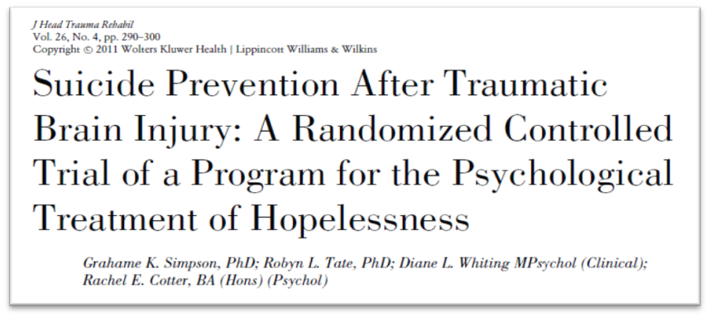
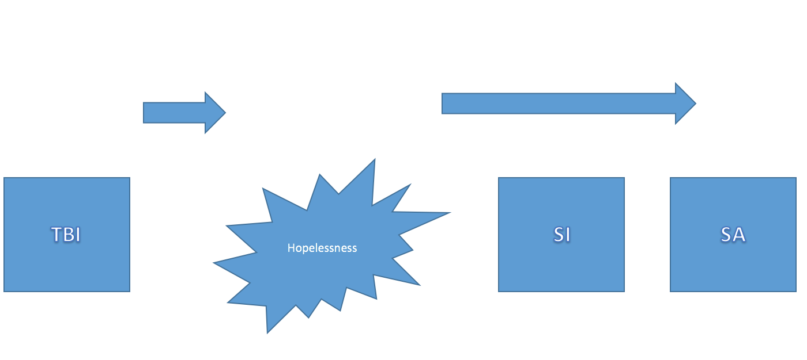

Slide 10
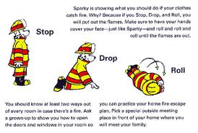
Positive Lifestyle – EASE
Eating
Activity
Sleep
Exercise
How to be a STAR
Problem Solving
Spot the problem
Think of options
Act on best option
Review how it went
Take Another Look
Cognitive Restructuring
Stop
Drop
Roll
Building Hope
Post Traumatic Growth
Self-esteem/ value
Finding connection
Sense of purpose
Expect good things

Slide 11
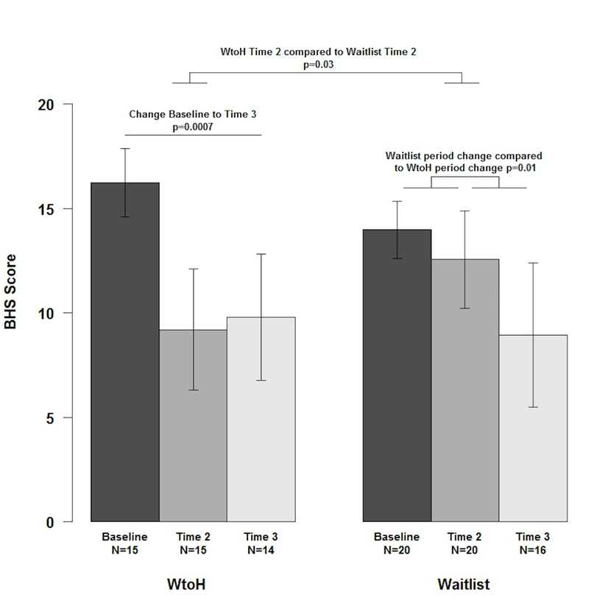
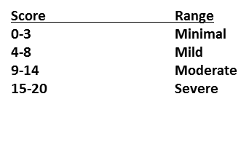
Overview
VA Window to Hope
Funding provided by the Military Suicide Research Consortium through the Department of Defense
Lisa A. Brenner, Ph.D., Jeri E. Forster, Ph.D., Adam S. Hoffberg, MHS, Bridget B. Matarazzo, Psy.D., Trisha A. Hostetter, MPH, Gina Signoracci, Ph.D., Tracy Clemans, Psy.D., and Grahame K. Simpson, Ph.D.

Slide 12
Please describe what the intervention contributed to you. What was its impact after the intervention was completed?
...I have found that I have sustained the intervention techniques and now use them without a cognizant thought. With these new techniques, I found that I have more hopefulness in attaining my goals and hopelessness is now filed away and not attainable easily, it is not the first thing I grasp.
To be able to breathe with knowing that ending my life is not the answer. Just to take a deep breath of fresh air it seems like. And it feels good.

Slide 13
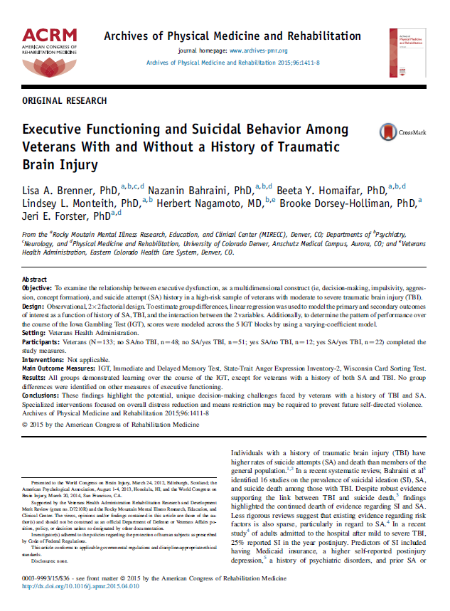
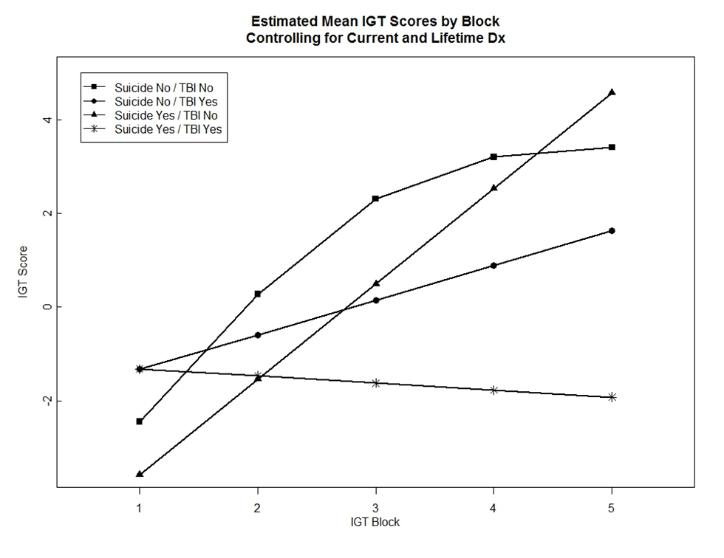
Objective: To examine the relationship between executive dysfunction, as a multidimensional construct (i.e., decision making, impulsivity, aggression, and concept formation) and suicide attempts
Design: Observational, 2x2 factorial design
Setting: Veterans Health Administration
Participants: 133 (No SA No TBI: n=48, No SA Yes TBI: n=51, Yes SA No TBI: n = 12, Yes SA Yes TBI: n = 22).
Main Outcome Measures: Iowa Gambling Test (IGT), Immediate and Delayed Memory Test (IMT/DMT), State Trait Anger Expression Inventory (STAXI-2), Wisconsin Card Sorting Test (WCST)
Veterans Health Administration RR&D Merit Review Grant Project #D7210R

Slide 14
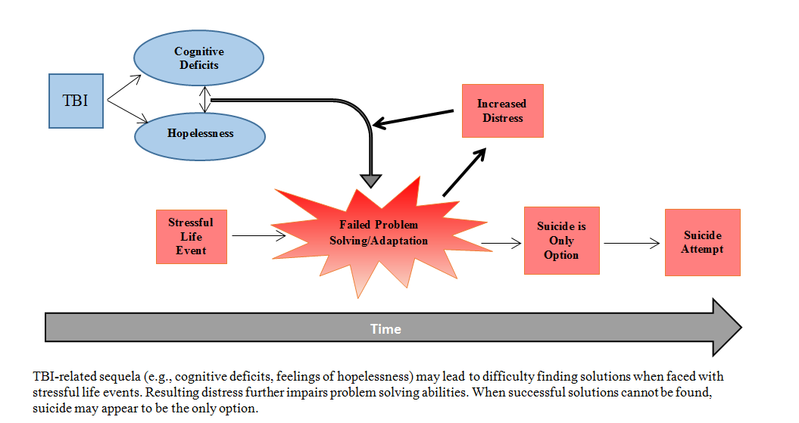

Slide 15
PST-SP
Problem Solving Therapy Strategies (Emotional regulation & planful problem solving skills)
Facilitate Safety Planning (Action Plan)

Slide 16
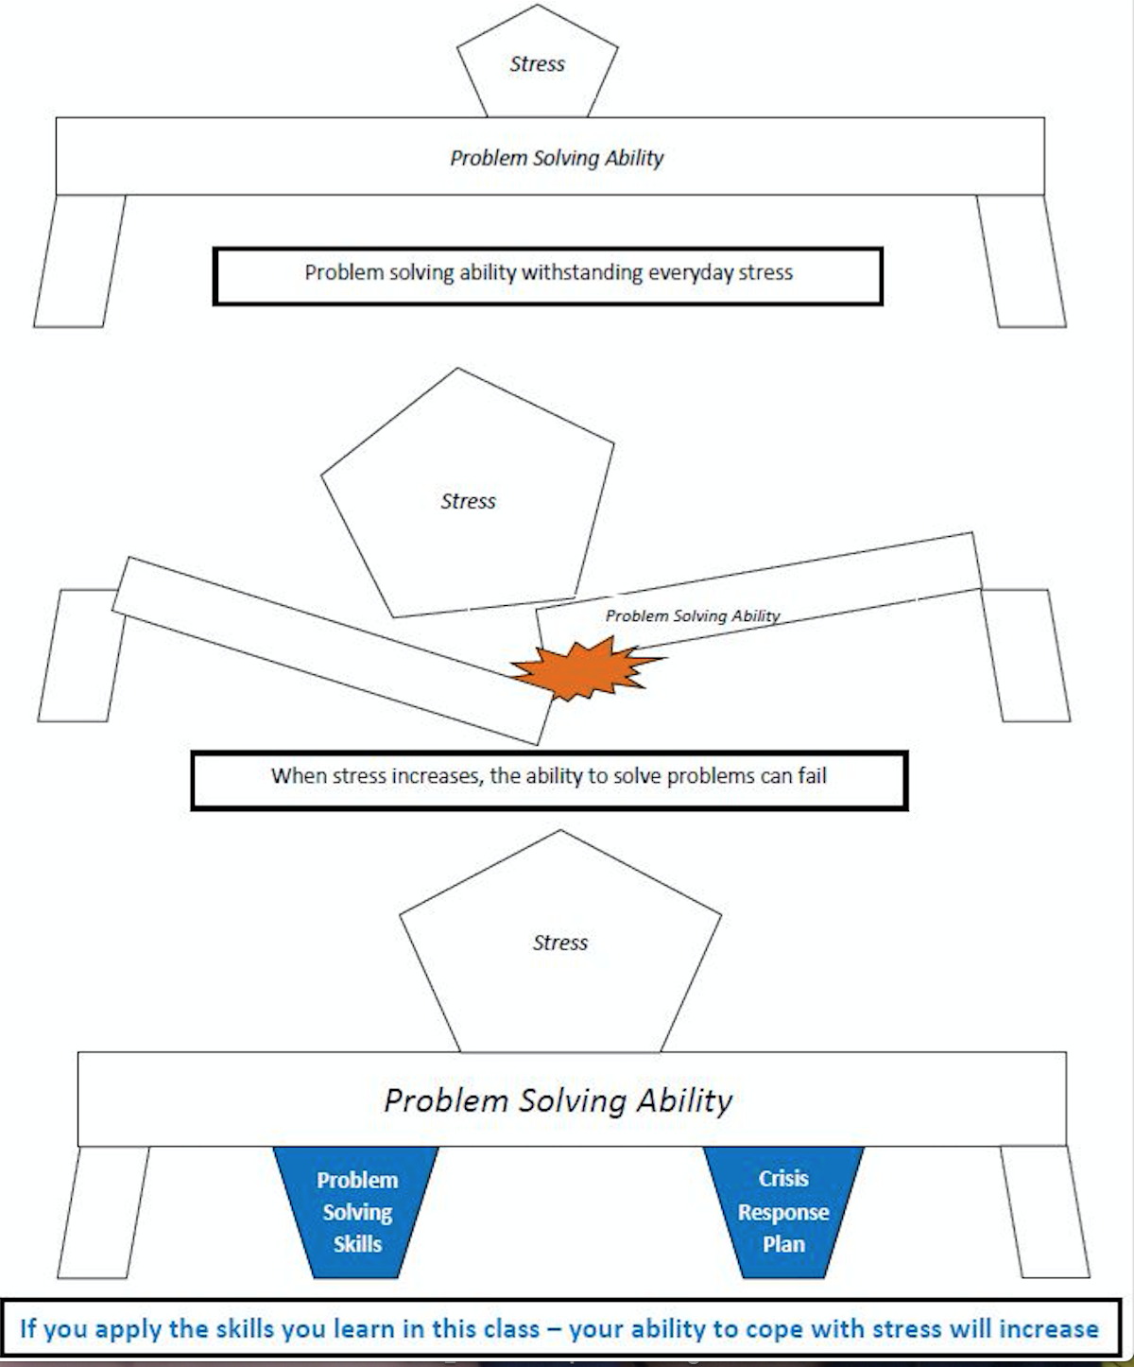
I know that I am not going to make hair-brained decisions. I am going to use at least some, if not most of the coping skills we learned here.
It contributed insight for me into myself, into the way that I deal with problems. It opened my eyes to the bad what in which I deal with problems. I don’t even recognize them and now I have the ability to definite a problem that is confronting me. I do understand that all problems can be worked through.

Slide 17
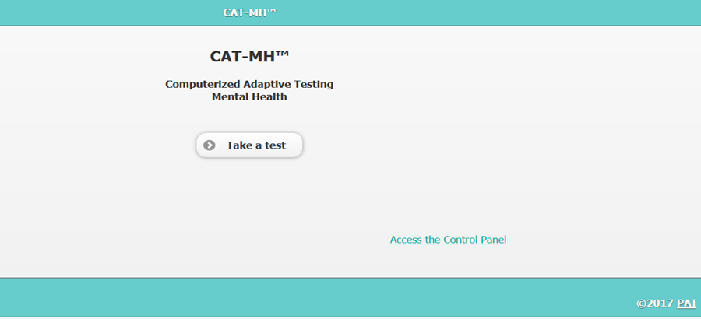
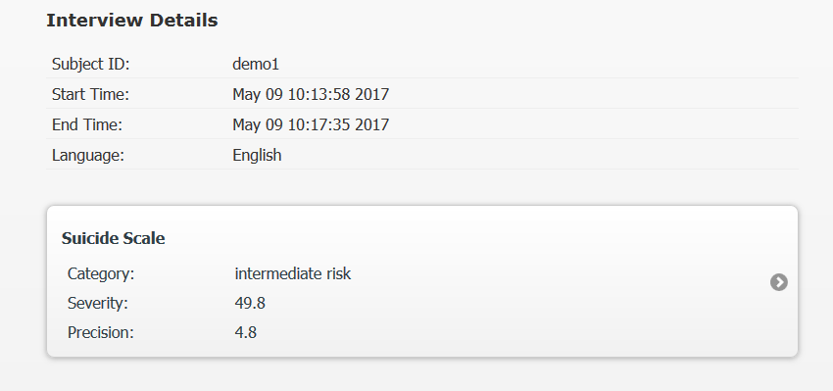
Suicide Risk Screening & Assessment
COMPUTERIZED ADAPTIVE TESTING (CAT) AND SCREENING FOR SUICIDE RISK
Adaptive measurement of suicide risk based on the joint measurement of suicidal thoughts and behavior as well as symptoms of depression and anxiety that have been demonstrated to be the precursors of the emergence of suicidal self-directed violence (e.g. anhedonia and hopelessness).
Barrier Addressed: Lack of reliable measures that can be feasibly administered in routine practice settings to accurately detect suicide risk and inform clinical decision-making.

Slide 18
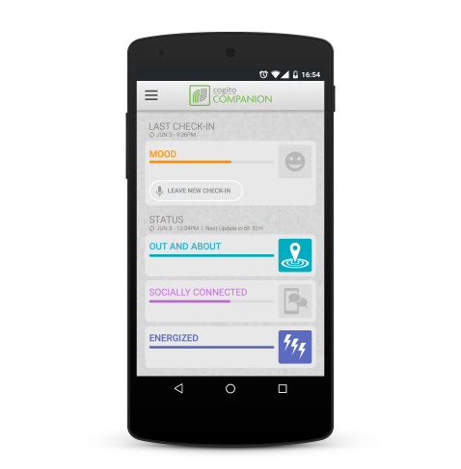
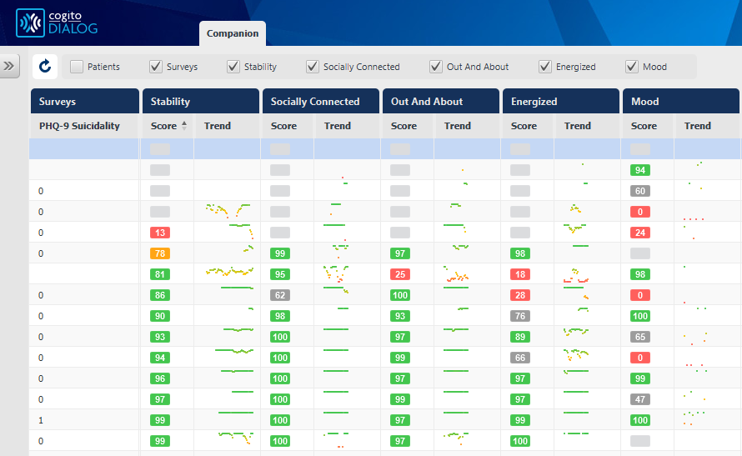
Suicide Risk Monitoring
Barrier Addressed: Traditional methods of self-monitoring such as health diaries can be unreliable, incomplete, difficult to interpret, and lack the ability to provide real time monitoring of suicide risk.
APPLICATION OF NOVEL MOBILE PHONE TECHNOLOGY TO SUPPORT VA SUICIDE PREVENTION EFFORTS (COGITO)
Cogito mobile sensing platform passively gathers behavioral information through a patient’s normal mobile phone usage and uses algorithms to compute validated behavioral indicators that may signify increased risk.

Slide 19
Treatment Engagement During Times of Transition
Barrier Addressed: Poor treatment engagement following psychiatric hospitalization, which contributes to increased suicide risk
Meet the Veteran on the inpatient unit
Telephone follow-up within one day of discharge
Ongoing telephone follow-up until engaged in care
Home visit during first week post-discharge

Slide 20
Access to Brief Evidence Based Psychotherapy for At-Risk Patients in PC Settings
Barrier Addressed: Limited resources and trained staff to deliver EBT for suicide risk factors in PC settings
Computerized Cognitive Behavioral
Therapy for Insomnia
6 weekly online treatment sessions of
40 minutes.

Slide 22
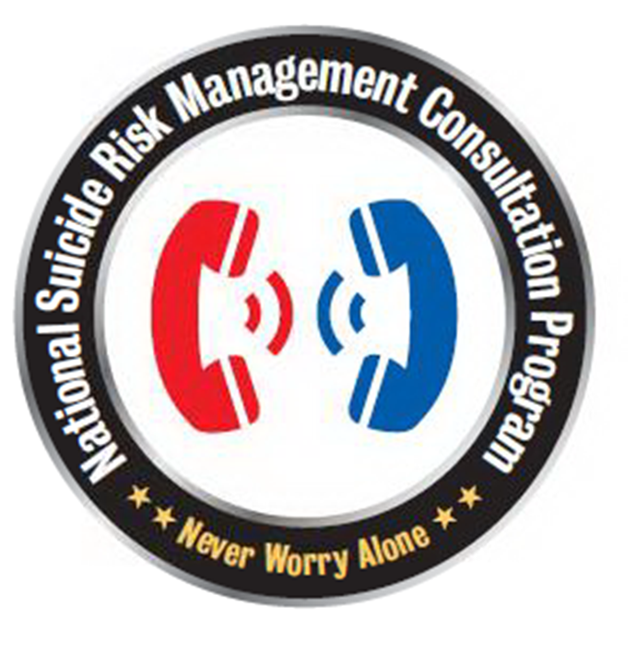
Suicide Consultation Services
NATIONAL SUICIDE RISK MANAGEMENT CONSULTATION PROGRAM
Provides one-on-one consultation to VA clinicians to enhance knowledge and confidence, and to provide emotional support in the aim of optimizing care of suicidal Veterans.
“Never worry alone.”
Barrier Addressed: Lack of professional support services to fill knowledge gaps and facilitate implementation of clinical practice guidelines among providers from various disciplines and treatment settings.

Slide 23
Check out the RMIRECC Podcast
@RMIRECC
@LisaABrenner
www.mirecc.va.gov/visn19
Lisa.Brenner@va.gov
Many thanks to our funders and collaborators

