Slide 1
Pearls of Wisdom NPC Wrap-up
Members of the 2022 Conference Program Planning Committee

Slide 2
Where it all began…

Slide 4
Takeaways – Sunday and Monday
1200.17 (Speaker: Woody Haskell):
Compensating VA employees is complicated and there are many rules. If there are questions, email dhaskell@navref.org
Read the Handbook thoroughly; use it as a frequent reference tool.
Clinical Trials Center (Ali Sonel, Loni Caffas, Jeff Moore):
To get buy-in from the MCD for a CTC think “Compliance”. Hire knowledgeable coordinators, establish quality budgeting skills and carefully assess feasibility of studies.
Separate coordinators work from regulatory work. Hire people who are energized to build a successful centralized culture.

Slide 5
Takeaways - Monday
The DEI Journey (Terry Allbritton)
Psychological safety involves people experiencing the freedom and safety to engage (rather than being focused on protecting themselves). Employees must feel that managers seem human, and moreover, managers must build trust with their employees by doing what they say they will do. Managers can also influence psychological safety by seeking feedback from employees about how well they, as managers, are doing. Doing so communicates that they trust and value employee input.

Slide 6
Takeaways - Monday
Talent Acquisition and Retention (Brenden Wright):
Broaden your traditional thinking. Make attracting top talent a strategic goal of your organization. Lead the way with new thinking, make your brand clear, get away from “the war for talent” mentality, and create opportunities that highlight “what’s in it for the employee”. Think social media, videos, interviews with current staff….
The rule of 4: Todd Carlisle who ran staffing/HR at Google and Twitter found that 4 interviews (4 different people) are enough to predict whether or not to hire someone with 86% accuracy.

Slide 7
Takeaways – Monday
The Wisdom of Indirect Cost Rates! How to Use and Sustain Them! (Betty Tingle and Alex P. Weekes)
Uniform Guidance 2 CFR § 200.332 provides requirements for pass-through entities. Provisional rates are commonly used. Seek out consulting if your NPC is struggling with rate negotiation.
Promoting Education and Research Learning Sessions at your NPC (Katrina Washburn, Kevin Hull and James McCallum)
Know the needs of your NPC’s education mission, match needs with funding opportunities and measure success. Helpful tool offered for tracking success; especially useful when reporting to your Board!
NPC cannot receive revenue to place medical students on a fee per student basis.

Slide 8
Takeaways - Monday
Strategic Planning (Michele Packard-Milam)
70% of board discussions should be of a strategic nature. Start with clear mission and vision statements. Perform a SWOT. Start small. Consider calling it a business plan.
The P.E.A.R.L.S of NPPO Auditing: Navigating NPPO (Jeteseya Dennis and Woody Haskell)
Read the notification letter to prepare early on. Make sure to justify expenses.

Slide 9
Takeaways - Tuesday
Key Performance Indicators (KPI) Pearls of Wisdom for NPC Board: Best Practices for Meetings, Agendas, and Reports (Michele Packard-Milam)
Ask first: What do we need to know? Create KPIs with strategic goals in mind and use them to tell a story. Allow enough time to collect and analyze the date. Give your board the full packet at least a week in advance of the meeting to make the most of the meeting. Remember 70% of Board discussions should be strategic.

Slide 10
Takeaways - Tuesday
Using Checklists in Pre and Post Award Grants Administration (Rebecca Walker and Maggie McCarthy):
3 main points for discussion and preparation in pre-award: Time, Money, People. Use free resources: templates available on Federal Demonstration Partnership (FDP) website.
Create a checklist that works for you, but can be understood by someone other than you. It’s not a training manual, it’s reminders. Training should take place first!
Monitor your projects every 30-60 days and look for problems, Do not use checklists as a replacement for training or in lieu of conversations with the PI, Share resources with each other.

Slide 11
Takeaways - Tuesday
Formation of a Pearl: Building a Sustainable Multi-Site NPC Model (John Givens, Danielle Fleumer and Cindy Reutzel)
Economies of scale (frame this from the VA ecosystem perspective)
Request business plan from the prospective site and understand other requirements in 1200.17
Provide board with clear plan for how to account for funds, manage IDC, budgets in deficit, dissolution terms, etc.
Must include the prospective site Medical Center Director on the multi- NPC Board, but not other statutory members per 1200.17.

Slide 12
Takeaways - Tuesday
Pearl Jam: How to Rock it in Clinical Trials (Kelly Willenberg)
Budget for hidden costs: Delayed study start-up, delayed IRB approval, time to review and implement changes due to amendments or safety reports, etc.
Board Responsibilities: From Financial Statements to Fraud (Bennie Lewis)
Provide regular and comprehensive, but easy to understand, reports to board and PIs. Establish and maintain effective internal controls.

Slide 13
Takeaways - Tuesday
Fundraising: Revealing your Luster (Kevin Hull)
Survey your local landscape for relationships you can rely on to get referrals to potential funding sources to then do your homework on their giving scheme and spheres of influence to determine your best approach
Relationships take initiative and sustaining investment to see through to fruition so treat them accordingly (get that fish more than just on the boat — get it on the grill, baby!

Slide 14
Takeaways - Tuesday
VA Central IRB Update: Energy and Sustainability (Don Workman)
Added a Panel #3 for Central IRB administration for lower volume IRBs
Fiscal year 2023 goals: piloting a new Rapid Response VA CIRB process, revised and simplified SOPs, simplification of forms, removal of redundant questions on forms, introduction of new smart-forms, webinars with CIRB liaisons, and additional consent form templates.

Slide 15
And where it ended…..

Slide 16
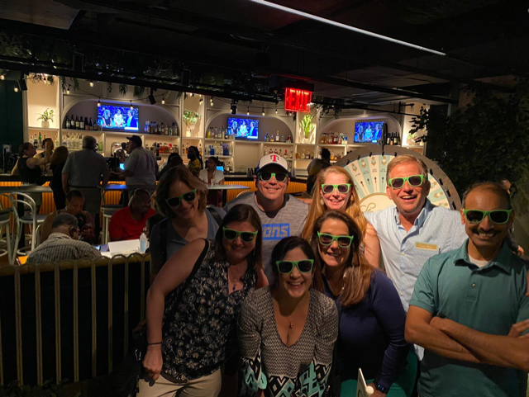
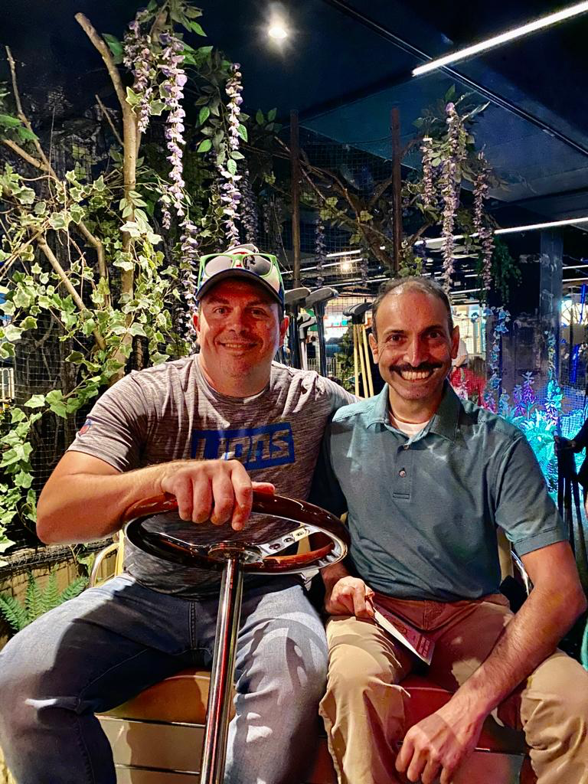

Slide 17
Thank you
someone@example.com

