Slide 1
Spur Fundraising for Your Organization
Anything can happen if you let it!

Slide 2
Who is Heidi Webb, CFRE & What is Green Kite Fundraising? *21-year fundraising veteran * Certified Internationally *Rotarian
* Fundraising Roadmaps * Year-End Campaigns * Capital Campaigns * Board Training * CEO & CDO Coaching * Interim D.D.

Slide 3
Overview of Fundraising In every job that must be done, there is an element of fun!

Slide 4
Anecdote time!

Slide 5
Something’s not right…

Slide 6
You are a nonprofit – there are resources out there just for you!

Slide 7
Who’s Jennifer Brunner, MBA? * 20-years in sales, marketing, special events and conferences. * Currently ABD for a Doctorate of Business in Leadership Studies.
* Marketing Roadmaps * Social Media Marketing * Special Event Planning * Sponsorships * Digital Design

Slide 8
Building the Swell
Take flight!
Why Marketing + Fundraising = Success!

Slide 9
Deeper Dive – Your Choice!
Foundation Grants / Social Media
/ Individuals / Corporations / Events

Slide 10
Year-End Advice
There’s the whole world at your feet!

Slide 11
If you don’t plan, you plan to fail… So, what’s on Your Roadmap?
It’s Workshop Time!

Slide 12
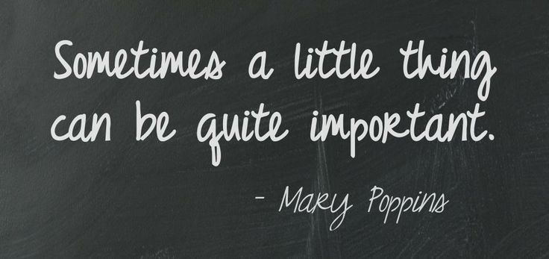
Lessons Learned
Share a new best practice!

Slide 13
We’ve got goodies!

Slide 14
Questions?

Slide 15
Thank you for your time and attention! Let’s Connect! Today or never, that’s our motto!
Heidi Webb, CFRE
240-328-8254
Heidi@greenkitefundraising.com
www.greenkitefundraising.com
@FundraisingAdventures
Jennifer Brunner, MBA
330-357-9132
Jennifer@greenkitefundraising.com
www.greenkitefundraising.com
@FundraisingAdventures

